Slide 1
Twitter Text Mining and Stock Price Movement
Jason Zhang
Eric Yang
Chenning Zhang

Slide 2
Research Questions
1. Are there correlations between tweets sentiments and stock prices within a week? How are they related?
2. Could tweets sentiments be instructive on predicting stock movement？

Slide 3
Data Extraction, Preparation
Acquire Twitter Sentiment
Collect tweets relevant only to stock ticker
Twitter API calls through Rtweet package
Tweets data including user_id, text, symbols included in tweets, and date
Stock Price Price Retrieval
Collect stock price using Yahoo Finance Data
Pricing Data including, date, daily high, low, close,trading volume, and adjusted daily price

Slide 4
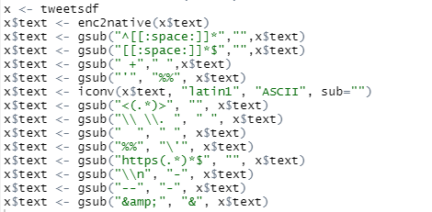
Data Cleansing
Twitter Data Cleansing
Remove leading whitespaces
Remove trailing whitespace
Remove extra whitespaces
Replace apostrophes with %%
Remove emojis
Remove Unicodes
Replace double space with single
Remove URL
And more …...
Stock Price Cleansing
Select closing price and date
Extract and convert date column

Slide 5
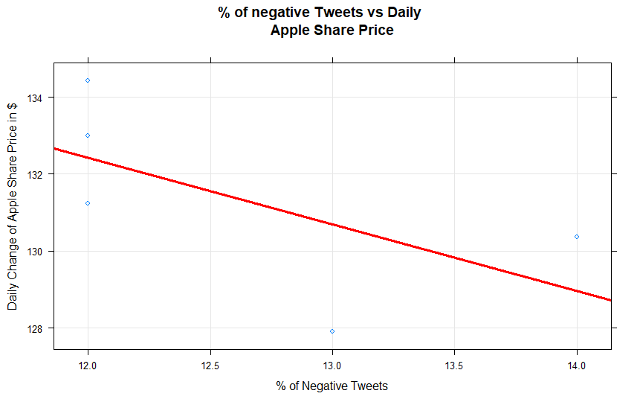
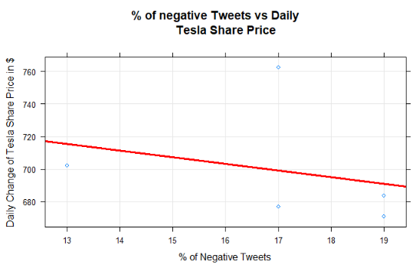
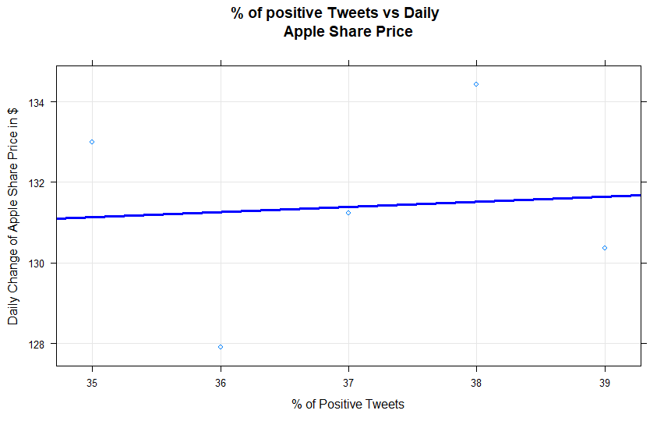
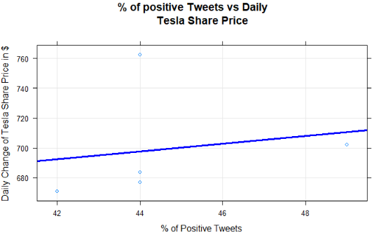
Observation and Conclusion
Correlation Comparison
Negative sentiments have more predictive power than positive sentiments.
Be aware of the change in public sentiment on social media and adjust your portfolio accordingly.
 | Apple | Tesla
Negative Sentiments | -0.68 | -0.27
Positive Sentiments | 0.08 | 0.181

Slide 6
Recommendation and Limitation
Larger datasets are likely to generate deeper level insights
Seek for creative ways to quantify sentiments using various dictionaries
Include more stock tickers allow to smooth variance in sentiment

